Slide 1





CUSTOMER EXPERIENCE: THE 14BN RISK NOTES FOR DISCUSSION
SEPTEMBER 2018
© Oliver Wyman

Slide 2
CONFIDENTIALITY
Our clients’ industries are extremely competitive, and the maintenance of confidentiality with respect to our clients’ plans and data is critical. Oliver Wyman rigorously applies internal confidentiality practices to protect the confidentiality of all client information.
Similarly, our industry is very competitive. We view our approaches and insights as proprietary and therefore look to our clients to protect our interests in our proposals, presentations, methodologies and analytical techniques. Under no circumstances should this material be shared with any third party without the prior written consent of Oliver Wyman.
© Oliver Wyman

Slide 3
Contents
Introduction: The €14bn opportunity
Digitisation and Customer Experience
Customer Experience as a value driver
How can Oliver Wyman help?
Why Oliver Wyman

Slide 4


Why does customer experience matter?
1. Introduction: The €14bn opportunity
€14bn of customer value at risk due to customer experience
Customer Experience
Digitisation
2/3 of clients work with more than one bank and 40% of them are looking for banking alternatives
There are different client behaviours coexisting in most markets, digital only and branch only clients, but most of them are heavy users of all channels
Banking clients are increasingly open to share their data and engage with third parties to satisfy their financial needs
“Digital” customers are more satisfied across all aspects of their relationship with the bank
Strong correlation between digitalization, customer experience and client attrition
Negative experiences are concentrated in non digital channels, especially within the higher value segments
There are new alternatives (e.g. financial platforms) that are shifting the understanding the financial services industry
Flow of customers from less digital to more digital banks
+
Estimated value at risk of up to 15% of net margin – €14bn¹
Value at risk is typically linked not to one but to several different hassles by segment
Customer experience needs to be linked to economics and actions need to be prioritized to be efficient
Leaders are improving economics by better targeting investments and better protecting revenue
1. Countries in scope of the analysis: Germany, Spain, France, Italy

Slide 5
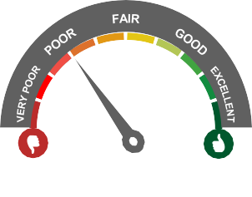





Poor customer experience has strong impact on client value
1. Introduction: The €14bn opportunity
Quantified impact of hassles in retail banking Customer Experience (Spain example)
65%
44%
31%
67%
Have downgraded or maintained their opinion of their bank
Would not recommend their primary bank to anyone
Overall satisfaction score less than 5 with their bank
Experienced at least one hassle with their bank in the last year, 29% experienced more than 3 hassles
1/10
1/6
1/4
Abandon the bank (half of them maintain a c.a. and may not be accounted as churn)
Reduce their relationship with the bank
State their intention to reduce relationship – 25% of them do not know where to go; further 11% is not sure whether they will intend to change
15%
Customer margin base at risk due to bad experiences….
€14BN for the 4 largest European countries¹
Source: OW customer survey
1. Germany, France, Italy and Spain

Slide 6

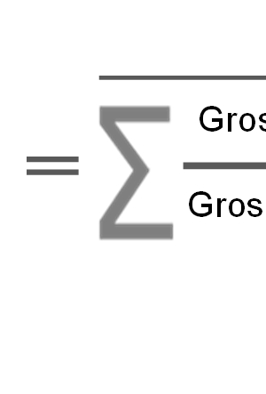
CVaR is calculated as the probability of decreasing relation because of bad experiences times the expected loss on value
1. Introduction: The €14bn opportunity
Customer Value at Risk CVaR
Attrition due to poor Customer Experience
Expected value loss
The probability of reducing relation will be calculated according the data obtained with the survey, having previously identified the clients who decreased their relation with the bank
Loss on value will be calculated based on historic data from clients who have reduced their relation
Therefore, expected loss on value will be calculated as:
This way, the probability of reducing relation for clients with bad experiences will be calculated as:
# clients who reduced relation because of bad experiences
Probability of reducing relation because of bad exp (%)
Expected loss on value (%)
Gro
Gros
ss margin _{t}
1
# clients who have had bad experiences
s margin _{t-1}

Slide 7
1. Introduction: The €14bn opportunity
In the four largest European countries, we estimate the total CVaR to be €14bn
Value¹
Probability of attrition
Expected Value Loss
CVaR
21
x
45%
x
52%
=
5
37
x
25%
x
46%
=
5
11
x
42%
x
53%
=
2
17
x
24%
x
50%
=
2
Net Interest Margin of Domestic banking groups and stand-alone banks. Source: ECB
“Intend to change” or “might consider changing” of primary bank. Source: OW analysis

Slide 8
Customer Experience and Digitisation
Section 2

Slide 9























Customer Experience satisfaction
Digital leaders are best performers and biggest entities are typically at or below average
2. Customer Experience and Digitisation
CX satisfaction across countries and banks
0-10
9
Top performers
8
Middle performers
7
Bottom performers
6
Source: Oliver Wyman analysis
Top 3 bank
Digital leader
Market average
8

Slide 10



Despite the metric used to monitor CEX, Digital banks perform better Illustrative example
2. Customer Experience and Digitisation
1
Satisfaction rates
2
Recommendation rates
3
CVaR
Bank 1
8,3
Bank 1
8,4
Bank 1
12,8
Bank 2
7,9
Bank 2
8,1
Bank 2
13,8
Bank 3
7,7
Bank 3
7,8
Bank 3
13,8
Bank 4
7,4
Bank 5
7,7
Bank 4
14,5
Bank 5
7,3
Bank 7
7,6
Bank 5
14,5
Bank 6
7,2
Bank 4
7,6
Bank 6
14,7
Bank 7
7,2
Bank 10
7,6
Bank 10
14,9
Bank 8
7,0
Bank 8
7,4
Bank 7
15,0
Bank 9
7,0
Bank 9
7,3
Bank 8
15,4
Bank 10
6,9
Bank 11
6,8
Bank 9
15,9
Bank 11
6,7
Bank 16
6,8
Bank 12
16,2
Bank 12
6,1
Bank 12
6,7
Bank 11
17,3
7,2
7,5
Best practices¹ Intermediates¹ Laggards¹
14,9
Digital:
We classified banks into digital best practice, intermediates and laggards according to 16 digitisation KPIs
1. Clusters defined based on OW Digital Banking Index, April 2017
Source: OW study, 2,241 surveyed customers in Spain, April 2017
9

Slide 11
Net Promoter Score
NPS is better for digital banks – Traditional banks wouldn’t be “net” recommended by their clients in Europe
2. Customer Experience and Digitisation
Spain
NPS
Italy
NPS
France
NPS
Germany
NPS
100
100
100
100
57%
50
50
50
50
27%
30%
18%
16%
0
0
0
0
-7%
-14%
-21%
-50
-50
-50
-50
-100
Digital Traditional
-100
Digital Traditional
-100
Digital Traditional
-100
Digital Traditional
Source: Oliver Wyman analysis

Slide 12
Whilst the full benefits of “digital” are yet to be fully demonstrated, it is true that digital players are more successful in attracting customers
2. Customer Experience and Digitisation
Net flow of customers between digital and traditional
% of customers switching bank segment
Net flow to digital
Net flow to digital
21%
17%
Digital
23%
3%
Digital
26%
9%
Traditional
Traditional
Net flow to digital
12%
4%
Digital
31%
19%
Digital
14%
10%
Traditional
Traditional
Source: Oliver Wyman analysis

Slide 13








“Digital” customers are more satisfied across all aspects of their relationship with the bank
2. Customer Experience and Digitisation
Illustrative
Primary bank customer satisfaction
Client perception on… (out of 10)
Fees and commissions
Interest rate (deposit, real estate, overdraft)
Comments
Laggards
Intermediates
Best practices
Accessibility shows to be the category in which Best Practice’s banks are most valued
1
Few errors / ethical
Transparent fees and commissions
Price
Reliability and transparency
Call center convenience Online channel
convenience
Offer quality
2
+
Possibility to talk with someone
Possibility to interact with the bank through online channels
Range and quality of offering
Ease of purchasing new products
Quality of fidelity programs
Lack of hidden fees
Bank’s ethics
Reliability and transparency presents one of the most exacerbated gap between Laggards and Best Practices
3
Gap
(Best Practice – Laggard)
2
Empathy
Easy accessibility to products and continuous communication
Accessibility
1
Online channel convenience
shows to be highly valued
3 among Best Practices and greatly differentiated from that of Laggards
No errors, effective management and required skills to meet clients’ needs
Speed and responsiveness
Process flexibility
Advice quality
Service quality
Personal advisory
Customer assistance
Branch access
4
Personal advisor and awareness of customers' needs
-
Service quality also shows to be among the most valued
4 categories among Best Practices despite the gap being smaller compared to other banks
Courtesy of employees
Ability to resolve customers issues
Branch location / schedules
Office design and image
4
5
6
7
8
Source: OW study, 2,241 surveyed customers in Spain, April 2017

Slide 14
Negative experiences are concentrated in non digital channels, especially within the Affluent segment
2. Customer Experience and Digitisation Illustrative
Hassle rate by channel (%)
Mass market – Online banks are excluded for branch and relationship manager
10%
9%
6%
5%
5%
5%
5%
3%
3%
2%
3%
3%
1%
2%
1%
2%
1%
0%
Branch Relationship manager ATM Call Center
Online
App
Hassle rate by channel (%)
Affluent – Online banks are excluded for branch and relationship manager
10%
10%
8%
8%
8%
8%
5%
6%
5%
4%
4%
2%
2%
2%
2%
1%
0%
0%
Branch
Relationship manager
ATM
Call Center
Online
App
Source: Oliver Wyman Observatory of clients’ experience, May 2015 - May 2017
Best practice
Intermediate
Laggard

Slide 15
Customer Experience as a value driver
Section 3

Slide 16
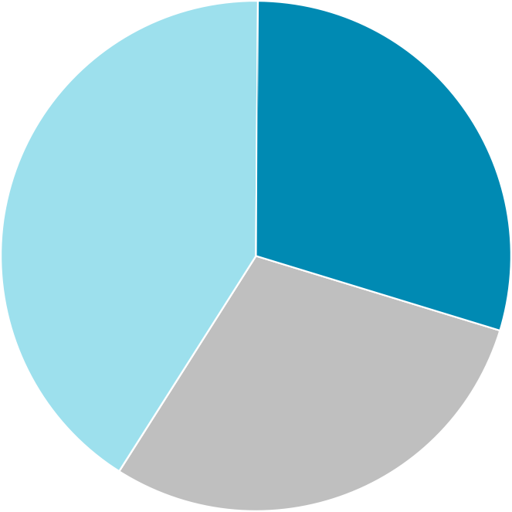
Banking relations per customer
Most customers already work with more than 1 bank
3. Customer Experience as a value driver
Number of banking relations per household
Germany
Number of banking relations per household
Spain
2 banks
1bank
30%
2 banks
1bank
12%
41%
45%
43%
29%
3or more banks
3or more banks
Sources: Oliver Wyman Digital Banking Survey Germany July 2017 | N = 2,006, OW study, 2,241 surveyed customers in Spain, April 2017
15

Slide 17
Desire to switch bank
Despite better average customer experience, Italian clients are less sticky than others
3. Customer Experience as a value driver
Spain Italy Satisfaction rate
9%
13%
45%
7%
42%
11%
31%
32%
-19%
100%
100%
64%
50%
Total market
Have changed Banks in last 2 years
Strong desire to change
Consider to change
Didn’t and don’t want to change
Total market
Have changed Banks in last 2 years
Strong desire to change
Consider to change
Didn’t and don’t want to change
6,78
France
Germany
5,51
14%
25%
6%
11%
24%
10%
13%
15%
100%
100%
61%
70%
Total market
Have changed Banks in last 2 years
Strong desire to change
Consider to change
Didn’t and don’t want to change
Total market
Have changed Banks in last 2 years
Strong desire to change
Consider Didn’t and to change don’t want
to change
Consider Didn’t and to change don’t want
to change
Source: Oliver Wyman analysis
16

Slide 18










Channel usage
Despite the fast increase in the digital channels, customers still have frequent branch interaction
3. Customer Experience as a value driver
Segmentation of users interacting with the bank depending on channels and frequency
Low touch online: Once a month or less
High touch online:
daily - weekly
+
Low touch branch: less than quarterly
-
Online interaction
-
Online / App only 17% 12%
Low touch 8% 2% Mix use of Onlin | Dominant online 22% 5% e and Branch
Dominant branch | High touch
10% | 32%
14% | 47%
4%
8%
Low touch
Neither Online or
17%
Branch
0%
2%
39%
Digital
Branch interaction
47%
Branch / RM only
32% High touch
High touch branch: Weekly - quarterly
32%
11%
18%
21% Branch
++
Spanish customers are still more “branch” than German ones
Sources: Oliver Wyman Digital Banking Survey Germany July 2017 | N = 2,006, OW study, 2,241 surveyed customers in Spain, April 2017 – Sample: 1,826
Note: In Germany Clients were asked how often they use mobile banking, how often the mobile app and how often they visit the branch for any activity beside cash withdrawal while in Spain
the question was “In the last 12 months, how frequently have you used the following channels to interact with your bank?”
17

Slide 19




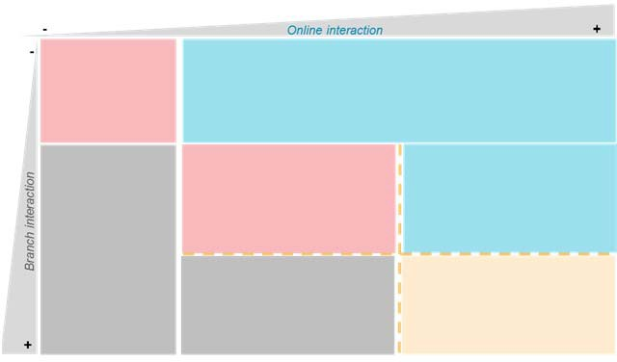


Channel usage
Key hassles are different by channel behaviour, making enhancements “trickier”
3. Customer Experience as a value driver Illustrative
Low touch Digital¹
Despite limited interaction, they care about availability
ATMs are key to digital users
Number and location of ATMs
Number and location of ATMs
Option to speak with a representative when using online
Option to speak with a representative when using app/mobile
Commuting time to reach the branch
ATM operational status
Low touch
Digital
Branch
High touch
Branch¹
High touch
Branch efficiency is important for
Branch hassles are more important than digital for hybrid
clients
Branch opening and closing hours
Branch opening and closing hours
Employees availability to assist you in procedures
Commuting time to reach the branch
Time required to execute basic operation
Option to speak with a representative when using online
1. Branch includes dominant branch and “Digital” includes dominant online
Source: Oliver Wyman Digital Banking Survey Spain April 2017 | N = 2,241
18

Slide 20

Channel usage by age group
We observe the highest degree of online/mobile banking activity for clients in their thirties
3. Customer Experience as a value driver
Segmentation of users interacting with the bank depending on channels and frequency by age group
Germany Spain
9%
7% _{9%} 7% 7% 8%
3%
6%
4%
4%
1%
4%
11%
16%
14%
19%
20%
17%
32%
32%
39%
40%
48%
38%
48%
52%
46%
47%
46%
47%
32%
31%
33%
33%
33%
34%
38%
34%
32%
32%
29%
30%
30%
29%
19%
20%
21%
11%
18-29
30-39
40-49
50-59
60 +
Overall
18-29
30-39
40-49
50-59
60 +
Overall
Low touch Digital High touch Branch
Sources: Oliver Wyman Digital Banking Survey Germany July 2017 | N = 2,006, OW study, 2,241 surveyed customers in Spain, April 2017
Note: Clients were asked how often they use mobile banking, how often the mobile app and how often they visit the branch for any activity beside cash withdrawal
19

Slide 21

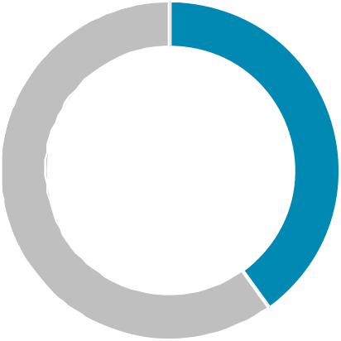
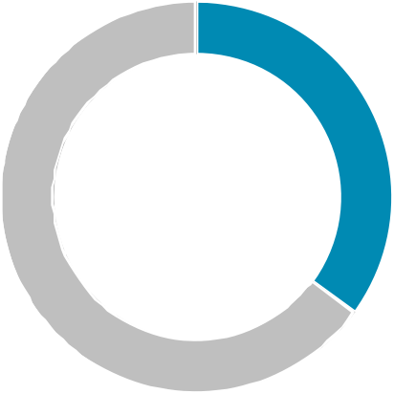
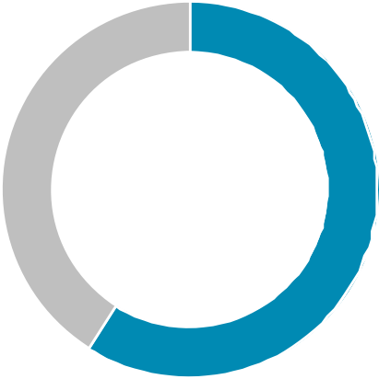
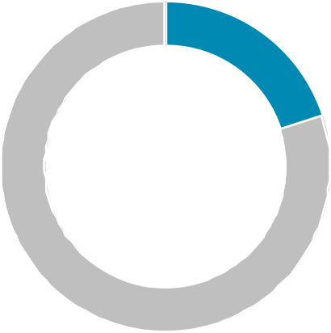
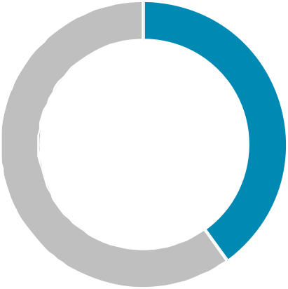
3. Customer Experience as a value driver
Product offerings and extra services
Bank relationships are becoming increasingly “open”
Illustrative
40%
35%
59%
…would provide their data for concrete product offers
…expect their bank to support with financial planning
…would purchase third party products through their primary bank
… knows that their bank offers the feature to connect different bank accounts
…are familiar with the concept of robo advisors
20%
14%
Source: Oliver Wyman Digital Banking Survey Germany July 2017 | N = 2,006
20

Slide 22
How can Oliver Wyman help?
Section 4

Slide 23








Our approach
A tested, quant based and result driven approach towards customer experience
4. How can Oliver Wyman help
Oliver Wyman Customer Experience approach
4
Solve hassles
Design Thinking approach
Engage most relevant areas of the bank in initiatives to solve customer experience
1
Customer Value at Risk
~250 interaction points covering key relationships, moments, channels and products
Ability to understand value by cluster
Linked to real economic behaviour
Risk of Reducing business (not only churn)
3
Heatmap
5
Build delights
Consolidated view of mismatches between
Customer Value at Risk and bank KPIs
Prioritize strategic actions according to value
Supports decision making
Client acquisition strategies based on positive customer experience
Cover and reinforce needs of our clients
2
KPI Dashboard
Translates “Experience Promise” into a set of hard KPIs
Covers key relationship moments by channel and product
Compares with best promises, benchmarks and aspirations
6
Monitor and continuously improve
Continuous tracking tool
Highlights changes and red flags
Builds virtuous circle based on value

Slide 24





Our competitive advantage
We have proprietary data and experience to support our project development
4. How can Oliver Wyman help
1
Our Survey
Our Client Work
Proprietary survey across multiple countries in Europe:
~250 interaction points
Key relationship moments
All channels
All product families
Tailored to client strategy
Linked to real economic behaviour
Hassles & delights
Sociodemographic
Granularity fits with strategy and operational model (e.g. channels to be considered)
Expected behaviour
Define customer value at risk, typically 15% of gross margin margin

Slide 25

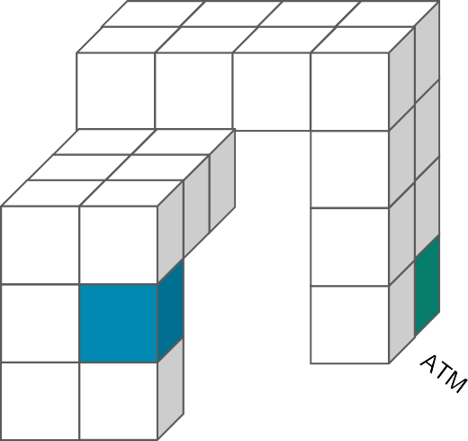





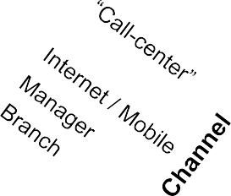
The first step is to understand the underlying value of our customer’s needs – CVaR approach
4. How can Oliver Wyman help
1
CVaR Methodology
Calculation dimensions of CVaR
Illustrative
Customer Value at Risk CVaR
Bank’s potential value loss if customer needs are not met
CVaR
6%
Segment n
Client segment
…
Segment 3
Segment 1 Call-center
P. Solving
3
ACX
30%
Attrition due to poor Customer Experience (ACX)
Segment 2
EVL
20%
Through a survey and observed client behaviours, we analyse the customer experience drivers of those clients reducing their relationship with the bank
Segment 1
Basic
Saving products
Credit products
Problem solving
Interaction
Expected value loss (EVL)
CVaR
4%
CVaR
10%
Segment 2
1 Brach
P. Solving
2
Segment 3 Internet
P. Solving
Value loss from those clients who have reduced their relation
Several client metrics can be used (gross margin, net present value, potential value, etc.)
ACX
20%
ACX
20%
EVL
20%
EVL
50%

Slide 26




A granular analysis helps prioritize efficient areas of intervention
4. How can Oliver Wyman help
1
Hassles ≠ CVaR
Some hassles are worth more than others
Some clients more affected than others
By segment (traditional, exclusive vs shared client,…)
By sociodemographic
(age, income…)
Example analysis
By province, by distance to branch…
CVaR
By channel behaviour
By branch type
Rest
Hassles rate
Some hassles are not linked to value destruction
…
Typically no “1 big issue to fix” but several
Example:segment mentioned has higher hassle rate
No significant differences across sregments
Medium differences
Multicha- Branch use nnel
Digital clients -
Large differences
Point of contact
Value Territories Province Age
Branch type
Compe- tence
Portfolio
Office
Core areas
MAL
Median age (30 –
Affluent branches
-
-
hours
VAL SEV MAD
50) years are worse
Multichannel clients
Waiting office times
Low value clients
East (35%)
AVI CAST
Median age (30 – 50) years are worse
Transactional branches
Shared clients
Heavy users
Clients who are not in a portfolio
Branch proximity
Low value clients
Non-core areas
TAR, GRA, MAL, CAD
Median age (30 – 50) years are worse
Shared clients
Digital clients Branch clients
Heavy users

Slide 27




In parallell, from the bank’s perspective a set of KPIs are defined to help the organisation embed its customer experience strategy in the business
4. How can Oliver Wyman help
Disguised client example
2
Experience promise layers
Attribute
Meaning for Experience promise
KPI definition
KPI embedding
Intrinsic characteristics of the brand and related to the business strategy of the bank
Translation of strategic levers into meaningful concepts of customer experience
Definition of key metrics to monitor and report performance
Metric embedding across segments, channels or products
APPROACHABLE
% customers stating they have no reference person in the bank
Low value
Medium value High value
Get to know and recognize the client
SIMPLE
% products that can be signed on with less than
(3) “clicks”
Easy to understand, simple to use
Web
App
TRANSPARENT
Low value
Medium value High value
Be professional and trustworthy
% customers stating they understand our products

Slide 28




Selected KPIs cover the whole spectrum of client interactions KPIs by channel and contact
4. How can Oliver Wyman help
Sanitized client example
2
Oferta final personalizada
Firma y contratación del producto
Realización de consulta
Realización de operaciones (i.e. transacción)
Renovación/ Cancelación de productos
Interposición/ Resolución de incidencia
Oficina
% de ofertas personalizadas
# de productos por cliente por segmento (LPs)
% de ofertas basadas en modelos de BI Tasa de venta cruzada por cliente
% de información completa en ficha comercial por cliente (mail)
% oficinas que hace venta
institucional
% de contratos que han sido revisados y adaptados
% de clientes por tipología
% de ventas que no cumplen criterio de necesidad cliente
% de clientes que entienden lo contratado Tiempo medio de respuesta en
hipoteca y préstamos
% operaciones que solo se pueden hacer en oficina de origen
% de comunicaciones que cumplen criterio de claridad - (ej. letra, págs, explicación riesgos)
% de clientes a menos de 1 km de una oficina
% de clientes invisibles por oficina Tiempo medio de espera en oficina/ oficina ágil
% de clientes que forman parte de un programa de fidelización y lo conocen
% de clientes que manifiestan haber tenido alguna incidencia
% de cumplimiento de plazos en procesos comerciales
% de clientes no carterizados con persona de referencia
% de los contactos a clientes (con gestor) realizados por su gestor de referencia
Gestor de referencia
% del número de
Tasa de éxito por campaña
clientes con los que se ha contactado en los últimos 12 meses
# de contactos (llamadas, correos electrónicos) por cliente en los últimos 12 meses
% de clientes que dicen tener una persona de referencia
% de clientes carterizados por segmento
Media del # de entrevistas por gestor en 12 meses
% de quejas no resueltas que exceden de 2 meses
% de cumplimiento de plazos en resolución de problemas
% de clientes con avisos por descubierto
% contratos que
% de contrataciones que se pueden realizar
cumplen criterio
% de clientes con productos preconcedidos
de claridad
% de interrupciones de contratación de productos online
Oficina Internet
% de contratos
por canal
% de productos que se pueden contratar en menos de 3 clicks
formalizables
% de clientes que utilizan funciones básicas en la oficina internet y móvil
de
forma no presencial
% de disponibilidad de sistemas (por canal, uptime)
% de clientes con regularizaciones en 12 meses
Cajero automático
% de mensajes personalizados
% de cajeros con funcionalidad avanzada
% disponibilidad de cajeros
Atención Telefónica
% de contratos
Tiempo de respuesta en canal telefónico
formalizables
de
Llamadas entrantes no atendidas
forma no
presencial
% de llamadas para aclarar consultas relacionadas con términos de contratación

Slide 29







A target ambition is set for each KPI, ensuring full coverage of the bank’s customer experience touchpoints
4. How can Oliver Wyman help
2
Illustrative KPI distribution in a bank- by channel and high level customer journey
KPI typology and ambition setting
KPI type
KPI ambition
Explore
Purchase
Use
Solve
KPI per channel
Channels
Branch
A
E
A
Average waiting time at branch
60 min
5 min
B
% of calls answered by call center within 20 seconds
RM
D
10%
90%
C
% Branches with smart ATM
Web
20%
80%
F
KPI per phase
% Contracts understood when
explained by RM
ATM
C
D
10%
90%
% Complaints solved in less than 1
month in Branch
% Complaints solved in less than 1
month online
E
40%
Call Center
B
80%
F
50%
70%
KPI
Current
Target/ ambition

Slide 30





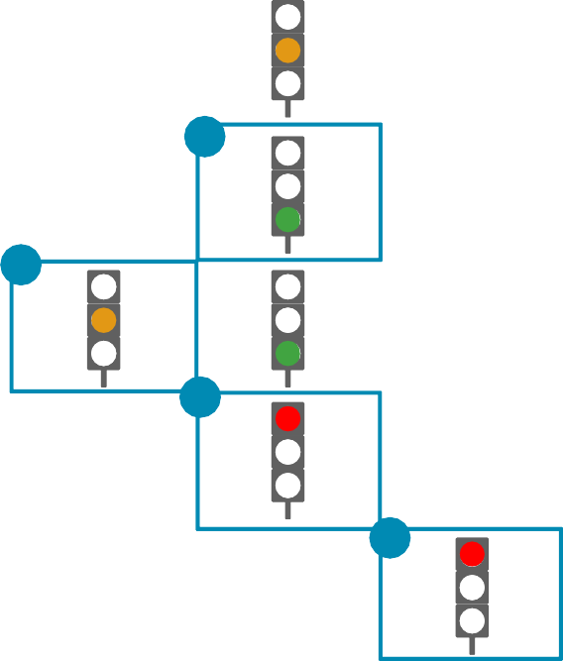




Identifying areas of focus of customer value and deviation on experience promise are the initial steps to improve customer experience
Illustrative example
4. How can Oliver Wyman help
3
CVaR and Experience Promise dashboard
Touch point
Customer need
Experience promise
Purchase
Use
Solve hassles
A
Customer visits a couple of times the branch looking for advise to buy a car
All employees are busy and the customer leaves
The bank has set a target of 5 minutes maximum average waiting time
Currently, the average waiting time is 13 minutes
Explore
Branch
A
B
Mortgage application process cannot be completed online
They are required to file paper work at the branch
The bank is reducing the time needed to grant a mortgage (17 days vs. a target of 15)
Some steps that still need to be performed at the branch
RM
C
Internet/ Mobile
B
Customers feel that they have less attention by their usual RMs
However, they appreciate the advantages of the newly developed online service model
C
Recently, the bank has reduced its physical RM coverage
The online RM model is still to reach its full potential
ATM
D
Call Center
E
D
Customers still use traditional ATM
They rely on the branch tellers for more complex transactions
The bank is pushing for a wider network of smart ATMs
At the moment they are only available in 25% of branches while the target is 90%
Customer Value at Risk
Not meeting Experience Promise Beginning to meet Experience Promise Exceeding Experience Promise
E
The bank has set an strategy to attend customer calls in less than 20 seconds
Their current outsourcer has an average time to answer the calls of 1 minute
Customers contact the Call Center to solve their issues
Waiting times have increased

Slide 31


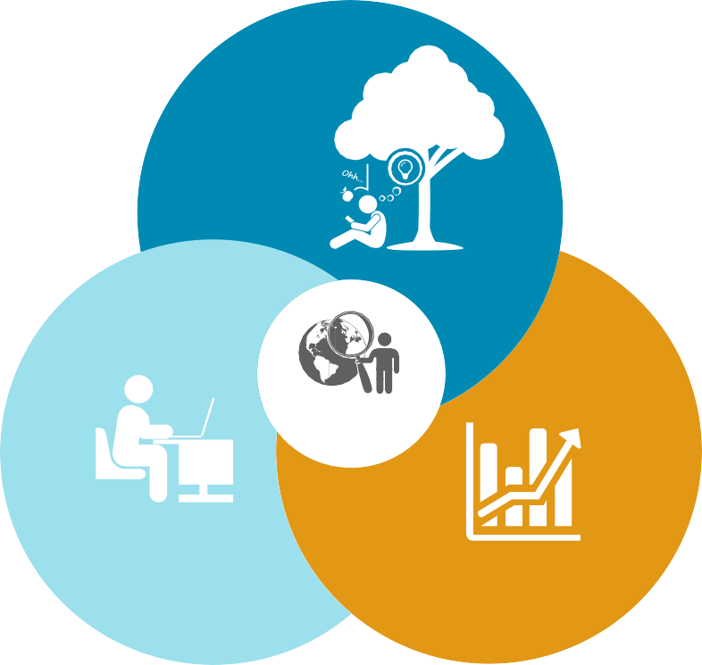
Design-led Customer Experience
To align the organization in defining the solution to solve existing hassles
4. How can Oliver Wyman help
4
5
Design-led Customer Experience
Deploy divergent thinking as a way to ensure that many possible solutions are explored in the first instance, and then convergent thinking as a way to narrow these down to an optimal solution for our customers
Let users compare alternatives, experience with proposed solutions and observe behaviour from the end user
1. Ideate
Solutions that are
Desirable
What people need and value
Embrace prototyping as a way to iteratively hone-in on solutions through the production of tangible customer experience initiatives that allow for robust feedback and engagement
Solution
Build on strengths of current operating capabilities
Feasible
2. Prototype
3. Test
Viable
Profitable, with a sustained business model

Slide 32
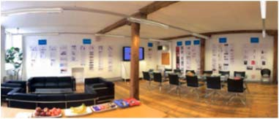








Interactive workshops
We will use our proven “StudioModel” methodology to further build on customer delights
4. How can Oliver Wyman help
4
5
About our StudioModel Workshop approach & format Roles
An open space to share, ideate, and create…
A number of workshops to solicit feedback and generate ideas
Cross functional & senior team engaged
Background work to frame the issues and provide a factbase for informed discussion
Peer insights used to complement internal learnings
Define scope and agenda of the workshops
Prepare materials for discussion for each session
Facilitate workshops using collaborative methodology (StudioModel method)
Synthesize and summarize findings from all of the workshops
…facilitated by our experienced coaches that help your team get creative (but still be pragmatic)…
Illustrative potential discussion topics
Branch lay-out
Client onboarding process
Credit process pain points
Product understanding
Branch operating hours
Governance
Data and tools for RMs
Implementation challenges
…getting buy-in from stakeholders, identifying potential challenges and efficiently prioritising based on user input
Credit institution
Define teams to participate in workshops
Organize logistics (e.g., invites, etc.)
Participate in the workshops

Slide 33

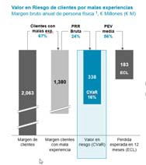
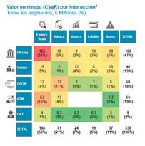
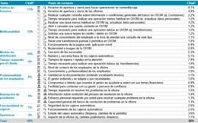
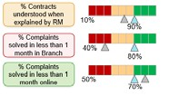
An automated tool helps ongoing tracking, management and evaluation
4. How can Oliver Wyman help
5
6
Experience based client management model
Tool Description
Periodical online survey
Random
Significant
3-6 months
Source 250 point survey
CVaR management tool
Next best action
Prioritization of hassles & WOWs
Client economic info
Client sociodemo- graphic Info
Client channel behaviour
Other client data
KPI
dashboard feed
Anonymized client data
Benchmarks

Slide 34

High-level project plan example To be tailored to client situation
4. How can Oliver Wyman help
Weeks
1
2
3
4
5
6
7
8
9
10
Customer Value at Risk
Ability to understand value by cluster
Linked to real economic behaviour
KPI Dashboard
Understand service qualtiy
Translates “Experience Promise” into KPIs
Heat map
Consolidated view of mismatches between value of customers and bank KPIs
Prioritize strategic actions and support decision making
Tool building
Program
Governance
Make it happen mobilization
Solve hassles
Build delights
Note: additionally there will be a phase zero to organise data request

